Slide 1
New York State Assisted Outpatient Treatment (AOT); A systemic overview and engagement considerations for Care Coordination
New York State Office of Mental Health

Slide 2
Scope
“101” of AOT (Background, purpose, eligibility criteria, oversight, roles, and AOT legal background/processes and removal information)
A training for Specialty Mental Health Care Management Agency Staff that serve AOT and Lead Health Homes

Slide 3
History
In January 1999, Kendra Webdale was pushed from a NYC subway platform to her death. She was pushed by a man living in the community who was not being treated for his serious mental illness.
Kendra’s Law (Mental Hygiene Law 9.60) was signed in August 1999 and went into effect on November 8th, 1999.

Slide 4
Purpose
Kendra’s Law has a dual purpose:
  To assist mentally ill individuals to live safely in the community, and
  To maintain safety in the community

Slide 5
Eligibility Criteria - MHL §9.60(c)
Eligibility criteria for AOT are based on the following factors and clinical determinations:
18 years of age or older
Living with a mental illness
Unlikely to survive safely in the community without supervision

Slide 6
Eligibility Criteria (continued)
History of lack of compliance with treatment
- prior to the filing of the petition, at least twice within the last thirty six months been a significant factor in necessitating hospitalization in a hospital, or receipt of services in a forensic or other mental health unit of a correctional facility or a local correctional facility, not including any current period, or period ending within the last six months, during which the person was or is hospitalized or incarcerated; or

Slide 7
Eligibility Criteria (continued)
- prior to the filing of the petition, resulted in one of more acts of serious violent behavior toward self or others or threats of, or attempts at, serious physical harm to self or others within the last forty-eight months, not including any current period, or period ending within the last six months, in which the person was or is hospitalized or incarcerated; and

Slide 8
Eligibility Criteria (continued)
(iii) notwithstanding subparagraphs (i) and (ii) of this paragraph, resulted in the issuance of a court order for assisted outpatient treatment which has expired within the last six months, and since the expiration of the order, the person has experienced substantial increase in symptoms of mental illness and such symptoms substantially interferes with or limits one or more life activities as determined by a director of community services who previously was required to coordinate and monitor the care of any individual who was subject to such expired assisted outpatient treatment order.

Slide 9
Eligibility Criteria (continued)
5. Unlikely to voluntarily participate in treatment
6. Court-ordered treatment is necessary to prevent relapse or deterioration
7. Likely to benefit

Slide 10
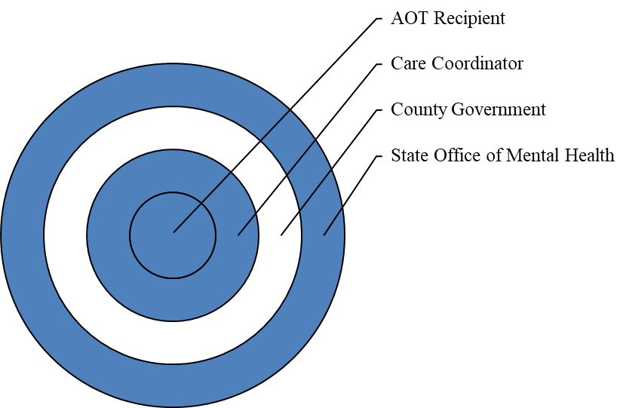
Concentric Circles of Oversight

Slide 11
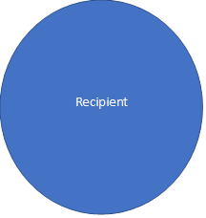
Systems
Try and keep in mind, that each recipient you serve is involved in multiple systems. These systems work better when they work with rather than for an individual and are able to communicate effectively.
Care Coord.
Medical/Health
Benefits/Insur
Ed/Work/ Vocational Supports
Med Mngmnt.
Housing
Non-Traditional/Natural Supports

Slide 12
Key Roles & Responsibilities
MHL §7.17(f)
OMH AOT Program Coordinator
  Oversees and monitors county AOT activities, including:
    Timely completion of investigations
    Timely provision of court-ordered services

Slide 13
Key Roles & Responsibilities
MHL §9.47(b)
County Director of Community Services (DCS) of the Local Government Unit (LGU)
  Accepts referrals of at-risk mentally ill persons
  Conducts timely investigations
  Files petitions for AOT when appropriate
  Coordinates timely delivery of services
  The Local Governing Unit (LGU) has a statutory role to govern the oversight of county and local not for profit service providers

Slide 14
Key Roles & Responsibilities
Care Coordinator (Care Manager / ACT)
Weekly contact with county AOT personnel - monitor and report non-compliance with court-ordered treatment plan
Mandatory weekly in-person contact with AOT recipient
Support recipient in pursuit of treatment plan goals
Assist in engagement with providers
Statutory reporting requirements

Slide 15
Care Coordination: Specialty MH CMAs
When an individual on AOT is assigned to Health Home:
ONLY designated Specialty MH CMA providers with prior approval to serve AOT population can enroll individuals on AOT.
AOT Order can be used to enroll recipient in Health Home, in lieu of refusal to sign 5055.

Slide 16
Health Home Plus (HH+) Services for AOT
Minimum of 4 in-person contacts per month for AOT
Provided by qualified staff with particular expertise (education and experience) and supervision
Smaller caseloads (not to exceed 1:20 ratio)
Services should never be changed for AOT recipients without the collaboration of the county.

Slide 17
AOT Consumer Visits/Contacts
In the Community
  Minimum weekly in-person contacts as specified in court order
    HH Care Coordinator must make a minimum of four contacts per month
    ACT Teams must make a minimum of six contacts per month
In Acute Care Setting
  Minimum 1 time per week in-person check-in expected for Care Coordination
In State Hospital/Jail
  Minimum in-person 1 time per month for Care Coordination, other providers (i.e recipient's clinical providers/housing providers or others involved in the AOT treatment plan) through collateral check-in. This is to ensure all AOT providers are on the same page with each other and the county.
  Minimum contact with mental health staff 1 time per week

Slide 18
Monitoring & Communicating with the LGU
SMH CMAs will work directly with the LGU, who is the local oversight entity for AOT.
The CMA must have means to communicate the following to the LGU:
Weekly Progress report - Written or oral reports that touch on each recipient’s progress in treatment plan goals.
The LGU May require other verification from CMA’s on HHCM services provided to AOT recipients monthly.

Slide 19

Reporting Requirements for AOT
CAIRS
  Additional reporting on Admission, follow up, and discharge on specific clinical detail that helps with statewide reporting requirements
AOT-specific Incident reporting (to the county)
Missing Persons and Diligent Search reporting (to the County) –
  includes NO discharge from Health Home if AOT recipient is still deemed “Missing” after 90 days

Slide 20
AOT Incident Reporting
CMAs must know how to report significant events that occur during the time an AOT order is active, and this is additional to other OMH required incident reporting.
Where to find the list of reportable AOT incidents/significant events: https://my.omh.ny.gov/analyticsRes1/files/aot/AOTGuidanceforReportingSignificantEvents11012017.pdf
LGU will work with CMA to determine appropriate follow up needed (eg, change to treatment plan)

Slide 21
Missing AOT Persons & Diligent Search
CMA must notify LGU within 24 hours of determining an AOT individual is missing.
Diligent Search Procedures for AOT – outlined in the HH+ SMI Guidance – see “additional Requirements for AOT” section.
The CMA and LGU shall maintain communication to determine additional follow-up efforts required.
Diligent search activities must be performed until AOT order is no longer ACTIVE.
HH+ rate can be billed for AOT Diligent Search activities until the member is located.

Slide 22
Balancing Mandated Treatment provision and Person-Centered Planning
Engagement in the community, where the individual is.
Involving Recipient in Decision Making.
Treatment Plan Goals- Make them meaningful and realistic, and maybe even fun. (I.e. “Recipient will engage with medical providers” or “Recipient will reduce swearing at care manager”).

Slide 23
Balancing Mandated Treatment provision and Person-Centered Planning (Cont.)
Try to avoid using our own values and beliefs in helping the individual find their way to better overall health.
Negotiating with the recipient/consumer about the real concerns and health risks, ultimately showing the consumer that their overall health is your goal in engagement.
Easier said than implemented. Being “real” with consumers is the best approach.

Slide 24
The Hearing
Live testimony by a physician is required by statute.
The examining physician must testify to the following:
  The individual meets AOT criteria
  Least restrictive alternative
  Specific treatment recommended
  Rationale for recommending AOT
The individual/Respondent may present evidence, call witnesses, and cross-examine adverse witnesses.

Slide 25
Disposition MHL §9.60(j)
Evidentiary Standard: Clear and Convincing
The proposed treatment must be the least restrictive alternative.
Initial orders may be granted for up to 12 months.
The court may not include a category of service which has not been recommended by the physician both in his or her testimony and in the treatment plan.

Slide 26
Treatment Plans
Categories of service
All court-ordered treatment plans must have either an ACT Team or a Care Coordinator.
AND may include:
  Medication
  Blood tests and urinalysis
  Individual or Group Therapy
  Day or Partial day treatment
  Educational and/or vocational training activities
  Substance use treatment and counseling
  Supervised Housing

Slide 27
Renewals MHL 9.60 (k)
Petition for renewal of an existing order must be filed within 30 days prior to expiration of the current order
Timely filing stays expiration of the current order
The renewed order may not exceed 1 year from expiration of the current order

Slide 28
Renewals (continued)
Authorized petitioners for renewal of AOT orders are limited to:
  County Director of Community Services (DCS)
  Family member who acted as the original petitioner, if he or she retains his or her original status
  Roommate who acted as the original petitioner, if he or she retains his or her original status

Slide 29
Applications to Stay, Vacate, or Modify orders - MHL 9.60 (1)
The individual, MHLS or other counsel, and any other entity acting on the individual’s behalf may move to stay, vacate, or modify the AOT order.
Service of all court papers is required upon the same parties served for the AOT petition that resulted in the order.

Slide 30
Removals
MHL §9.60(n)
When a physician determines that:
  An individual failed to comply with court-ordered treatment, and
  Efforts were made to secure compliance, and
  The individual may need involuntary admission to a hospital
  (This also applies to individuals with a missing status)
Then:
  The County DCS may order the removal and transport of the individual to a hospital for examination to determine the need for civil commitment
The examination is not to exceed 72 hours

Slide 31
Removals (continued)
If, during the 72 hour period:
  The individual does not meet the legal standard for involuntary admission and retention, and
  Is unwilling to remain voluntarily
Then:
  He or she must be released
Failure to comply with an AOT order is not grounds for involuntary civil commitment or a finding of contempt of court.

Slide 32
What The Numbers Say About AOT
  Reduced Incarcerations by 73%
  Greater engagement in service and use of prescribed medication
  Reduced homelessness by 64%
  Outcome at end of an order: Half leave AOT in a positive manner/10% leave for reasons unrelated to mental illness
  Decrease frequency & duration of hospitalizations by 66%

Slide 33
Additional Information:
To learn more about Kendra’s Law, visit the OMH website:
https://my.omh.ny.gov/bi/aot
THANK YOU!

